Slide 1
Mantid Release Presentation
Release 3.1
ISIS

Slide 2
What is this meeting
Release 3.1
Release planned Friday 7th February
Present the changes and improvements
No focus this time
What’s coming next

Slide 3

What we targeted for v3.1
ISIS
Live event data reduction
Logs
Multi Period
Automatic Reduction
Expansion to more instruments
Upload to ICAT
Training courses
More sessions
ISIS & ORNL
Recording
ICAT 4 Multi facility support
Various technique led improvements

Slide 4
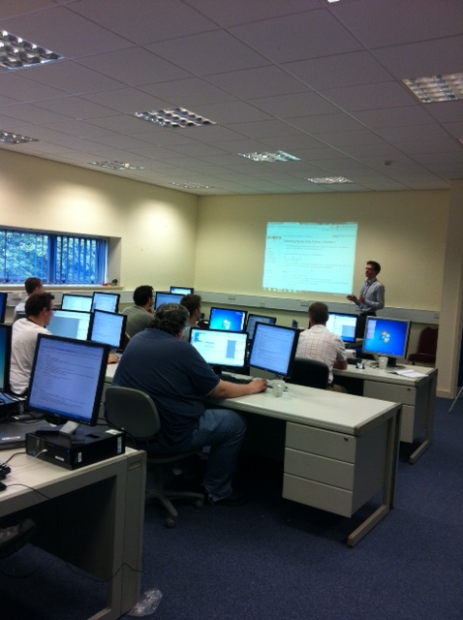
Training Courses
4 Courses
Introduction to Mantid
Introduction to Python
Python in Mantid
Extending Mantid using Python
Dates
8-10th January
14-17th January (ORNL)
To Book
Email: nick.draper@stfc.ac.uk
More details at www.mantidproject.org

Slide 5
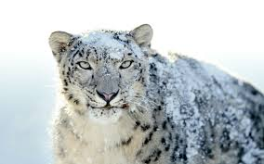

Supported Platforms
Staying the same
RHEL 6 64bit
Windows XP 32bit
Windows 7 64 bit
Ubuntu LTS 64 bit
Last supporting release
OSX Snow Leopard +
Future Releases
OSX Mountain Lion +

Slide 6
User Interface

Slide 7
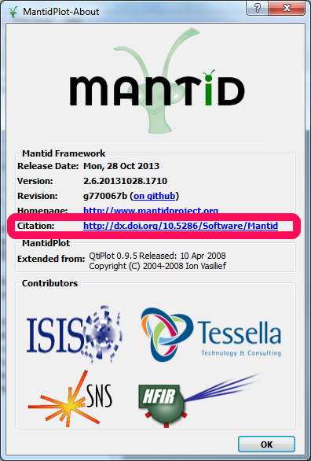
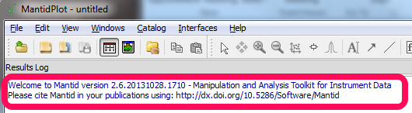
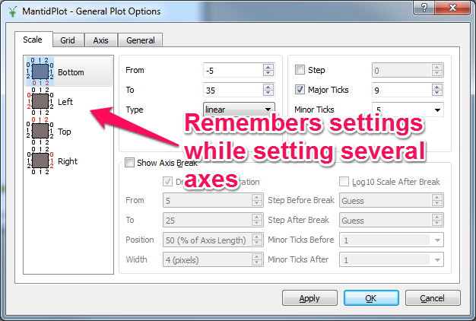
User Interface
Citing Mantid
Each Release is now assigned a new DOI
Easy to reference and search
General Plot Options

Slide 8
Framework

Slide 9
Framework
PSI
LoadSINQ
LoadFlexiNexus
McStas
LoadMcStas added (McStas 2.1 histogram and event data)
LoadMcStasNexus kept (McStas 2.0 histogram data)
Simulated
data
ISIS
data
Difference
data
-
=

Slide 10
Python

Slide 11
Python
Release 3.0 (Nov)
v2 only works
v1 removed
Version 1 is dead, long live version 2!
IPython replaces old script interpreter
Limited set of algorithms defined as functions on workspaces:
.delete()
.rename()
.clone()
.convertUnits()
.rebin()
.maskDetectors()

Slide 12
Indirect Inelastic

Slide 13
Indirect Bayes
We have a new interface for the indirect group
Brings together existing Bayesian fitting workflow algorithms
ResNorm
Quasi (previously Qlines)
Stretch (previously Quest)
JumpFit
Similar to IDA…

Slide 14
Demo

Slide 15
SANS

Slide 16
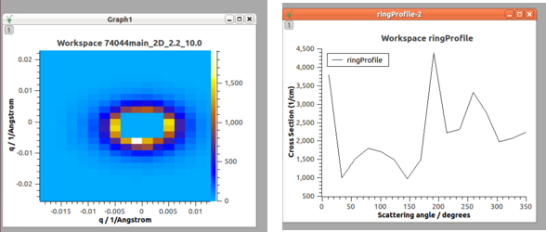
SANS
New Algorithm: RingProfile

Slide 17
Muon

Slide 18
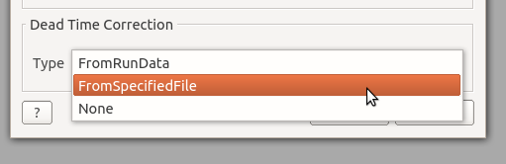
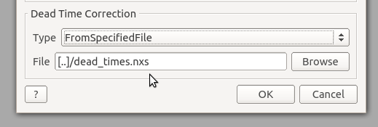
Muon
Dead Time Correction for PlotAsymmetryByLogValue

Slide 19
Reflectometry

Slide 20
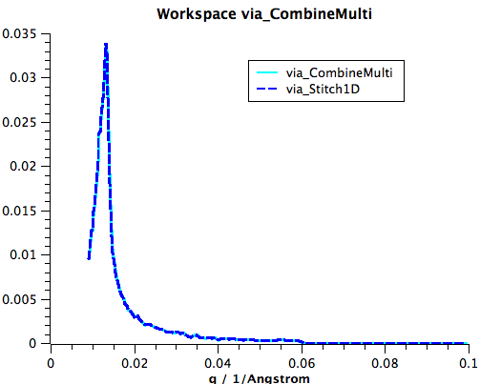
Reflectometry
Complete re-write of Stitch1D Algorithm
Identical results to combine2 python function
Algorithm has been tested and is being used at PSI
combineMulti script refurbished
Loops over Stitch1D (that’s all)
New Stitching Algorithm Stitch1DMany
Simpler inputs
Stricter input checking
Documented
Unit tested

Slide 21
Diffraction

Slide 22
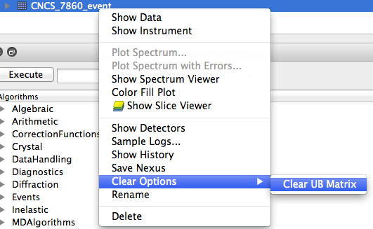
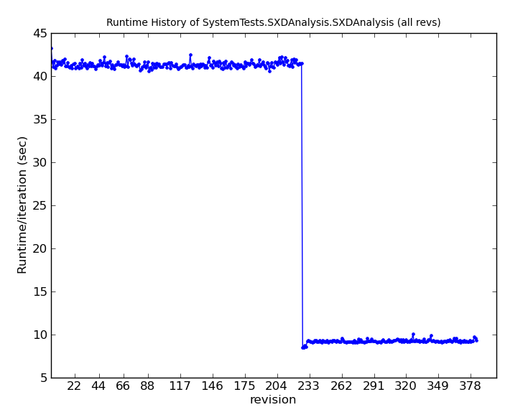
Algorithm Changes
New algorithm ClearUB
Right-click option
Major performance boost to ConvertToMD
Adaptable Q Radius for IntegratePeaksMD

Slide 23
Next Release

Slide 24
What’s coming in v3.2
ISIS
Various technique led improvements

Slide 25

Thank you

